Slide 1
GENETIC ALGORITHMS
GA is a Search/Optimization Algorithm.
GA is an adaptive method that evolves linear structures(chromosomes) by using genetic operators such as mutation, crossover.
Genetic programming is a variant of GA
The search is carried on hierarchical structures
The search carried out by GA is inspired by natural evolution
GAs are a subclass of Evolutionary Computing
GAs are based on Darwin theory of Evolution
2 components as Survival of the fittest and Variation
Every point in the search space is a possible solution thus it’s a fitness value.
This value is a measure of how close an individual is to the solution.

Slide 2
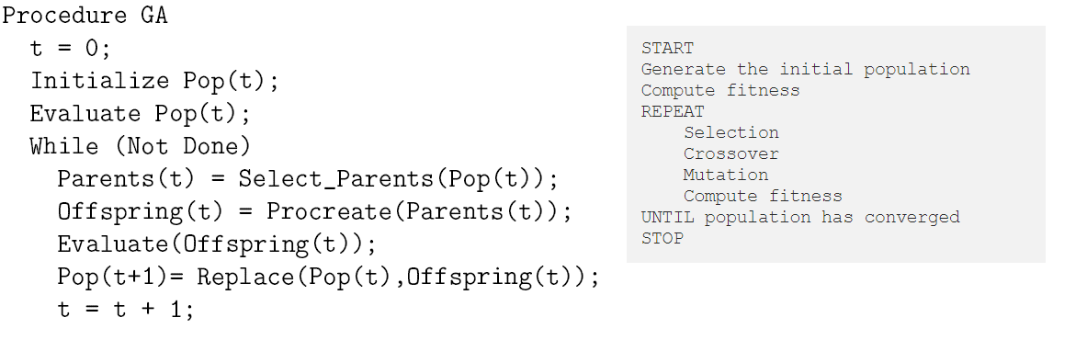
How it works
Start with an Initial ,set of n randomly chosen points from the search space
Repeat producing a next generation of individuals by reproduction until the solution is found.
Individuals with higher fitness value have more chance to reproduce.
If you like pseudocode here:

Slide 3
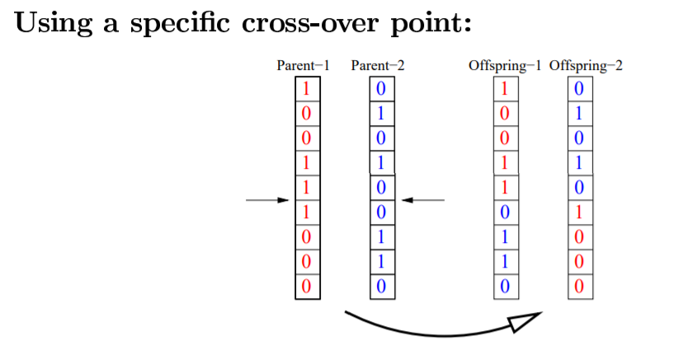
Mutation prevents the algorithm to be trapped in Local Minimum.
As an example, mutation can be done by flipping of one of the bits

Slide 4
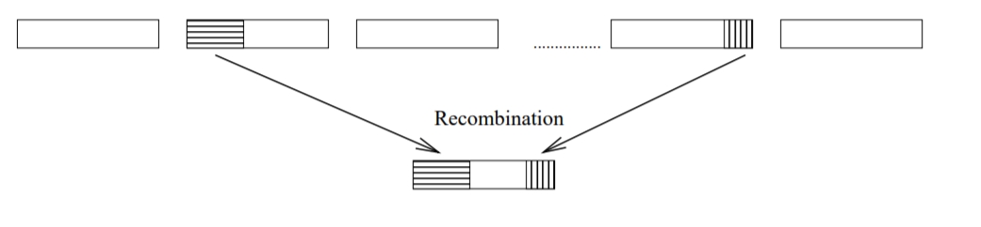
The Genetic approach aims to achieve the solution by combining blocks that appear throughout the search.
Being selected would mean having a high fitness.
High fitness would mean contributing to the global minimum(your target)

Slide 5
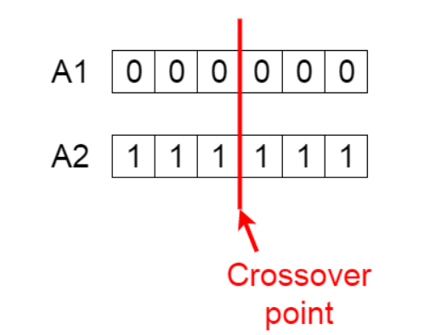
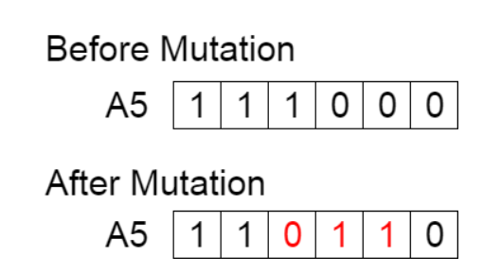
You have 5 phases (Simpler Guide to GA)
Initial population You start with random n points
Fitness function how fit an individual is and the ability of an individual to compete with other individuals. You give Fitness Score.
Selection Select fittest individuals
Crossover From pair of parents to be paired(mated), a random crossover point is chosen
Mutation some of the bits in the bit string can be flipped.

Slide 6
It’s a search algorithm hence you can use it in Transport! Check Traveling Salesman Problem
DNA Analysis
Designs where you suppose to upgrade/update frequently (i.e Aircrafts modern cars)
Economics Where you need complex models to make analysis of your market using GA can be helpful since you need to adapt and update your model all the time!
If you need to do optimization for your method or if your environment for your algorithm is changing frequently means you might use GA.
You can use GA to help your Neural Networks therefore NN can perform well!!! ( optimization)
Problems; Complex, not so easy to implement, not good when you have simpler tasks, Converging to the optimal(Global) point is not guaranteed.
Genetic Algorithms were popular before Machine Learning and Neural Networks ☹

